Slide 1
Shell Control Statements

Slide 2
Shell Control Statements
There are three components that we need to understand in any structured programming methodology:
Sequential execution
Conditional execution
Looping constructs

Slide 3
Sequential Execution
Sequential execution means that each command in a program script executes in the order in which it is listed in the program. The first command in the sequence executes first and when it is complete, the second command executes, and so on. The presence of functions in the code does not negate sequential execution; we can still follow the sequential flow of the instructions. As technology advances there is more parallel programming being run on smaller computers, but how that impacts sequential execution is beyond the scope of this course.

Slide 4
Conditional Execution
Conditional Statements: There are a total of five conditional statements which can be used in bash programming.
if statement
if-else statement
if..elif..else..fi statement (Else If ladder)
if..then..else..if..then..fi..fi..(Nested if)
switch statement

Slide 5
if statement
This block will process if specified condition is true. Syntax:
if [ expression ]
then
statement
fi

Slide 6
if-else statement
If specified condition is not true in if part then else part will be executed.
Syntax:
if [ expression ]
then
statement1
else
statement2
fi

Slide 7
An example of the code:
#Initializing two variables
a=20
b=20
if [ $a == $b ]
then
#If they are equal then print this
echo "a is equal to b"
else
#else print this
echo "a is not equal to b"
fi

Slide 8
if..elif..else..fi statement (Else If ladder)
To use multiple conditions in one if-else block, then the elif keyword is used in shell. If expression1 is true then it executes statement 1 and 2, and this process continues. If none of the conditions is true then it processes else part.

Slide 9
Syntax:
if [ expression1 ]
then
statement1
statement2
.
.
elif [ expression2 ]
then
statement3
statement4
.
.
else
statement5
fi

Slide 10
# if condition is true
if [ "myfile" == "myfile" ];
then
echo "true condition"
fi
# if condition is false
if [ "myfile" == "yourfile" ];
then
echo "false condition"
fi
In this example, we demonstrate the usage of if statement with a simple scenario of comparing two strings:

Slide 11
Nested If Else
Just like nested if statement, the if-else statement can also be used inside another if-else statement. It is called nested if-else in Bash scripting.
Following is an example explaining how to make use of the nested if-else statement in Bash:

Slide 12
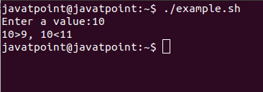
read -p "Enter a value:" value
if [ $value -gt 9 ];
then
if [ $value -lt 11 ];
then
echo "$value>9, $value<11"
else
echo "The value you typed is greater than 9."
fi
else echo "The value you typed is not greater than 9."
fi

Slide 13
#!/bin/bash
read -p "Enter a number of quantity:" num
if [ $num -gt 100 ];
then
echo "Eligible for 10% discount"
elif [ $num -lt 100 ];
then
echo "Eligible for 5% discount"
else
echo "Lucky Draw Winner"
echo "Eligible to get the item for free"
fi

Slide 14
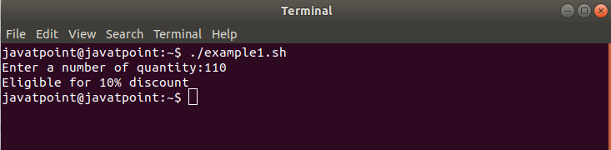
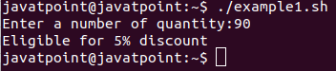
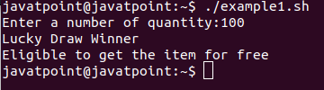

Slide 15
#!/bin/bash
read -p "Enter a number of quantity:" num
if [ $num -gt 200 ];
then
echo "Eligible for 20% discount"
elif [[ $num == 200 || $num == 100 ]];
then
echo "Lucky Draw Winner"
echo "Eligible to get the item for free"
elif [[ $num -gt 100 && $num -lt 200 ]];
then
echo "Eligible for 10% discount"
elif [ $num -lt 100 ];
then
echo "No discount"
fi

Slide 16
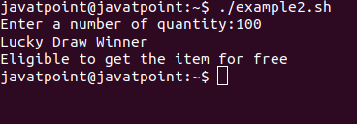

Slide 17
Case
In this topic, we will discuss the basics of case statements and how to use them in Bash scripts.
The Bash case statement is the simplest form of IF-THEN-ELSE with many ELIF elements. Using the case statement makes our bash script more readable and easier to maintain. These are generally applied to simplify the complex conditions having multiple different choices.
The Bash case statement follows a similar logic as the Javascript or C switch statement. There is a slight difference, as follows:
The Bash case statement takes a value once and tests that value multiple times. It stops searching for a pattern once it has found it and executed the statement linked with it, which is almost opposite in case of the C switch statement.

Slide 18
Case Statement Syntax
Syntax of the bash case statement is given below:
case expression in
pattern_1)
statements
;;
pattern_2)
statements
;;
pattern_3|pattern_4|pattern_5)
statements
;;
pattern-n)
statements
;;
*)
statements
;;
esac

Slide 19
#!/bin/bash
echo "Do you know Java Programming?"
read -p "Yes/No? :" Answer
case $Answer in
Yes|yes|y|Y)
echo "That's amazing."
echo
;;
No|no|N|n)
echo "It's easy. Let's start learning from javatpoint."
;;
esac

Slide 20
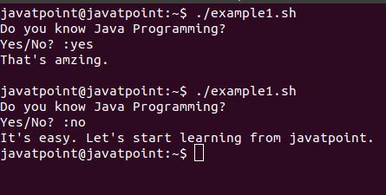

Slide 21
#!/bin/bash
echo "Which Operating System are you using?"
echo "Windows, Android, Chrome, Linux, Others?"
read -p "Type your OS Name:" OS
case $OS in
Windows|windows)
echo "That's common. You should try something new."
echo
;;
Android|android)
echo "This is my favorite. It has lots of applications."
echo
;;
Chrome|chrome)
echo "Cool!!! It's for pro users. Amazing Choice."
echo
;;
Linux|linux)
echo "You might be serious about security!!"
echo
;;
*)
echo "Sounds interesting. I will try that."
echo
;;
esac

Slide 22
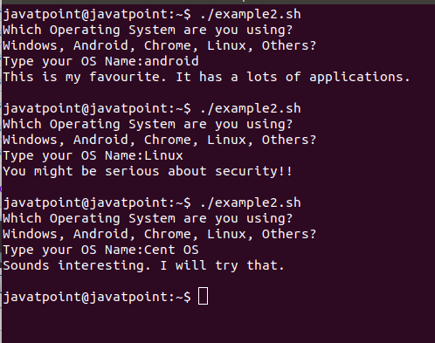

Slide 23
For Loop
In this topic, we will understand the usage of for loop in Bash scripts.
Like any other programming language, bash shell scripting also supports 'for loops' to perform repetitive tasks. It helps us to iterate a particular set of statements over a series of words in a string, or elements in an array. For example, you can either run LINUX command (or task) many times or just read and process the list of commands using a 'for loop'.

Slide 24
Syntax of For Loop
We can apply 'for loop' on bash script in two ways. One way is 'for-in' and another way is the c-style syntax. Following is the syntax of 'for loop' in bash shell scripting:
for variable in list
do
commands
done

Slide 25
for (( expression1; expression2; expression3 ))
do
commands
done

Slide 26
#!/bin/bash
#This is the basic example of 'for loop'.
learn="Start learning from Javatpoint."
for learn in $learn
do
echo $learn
done
echo "Thank You."

Slide 27
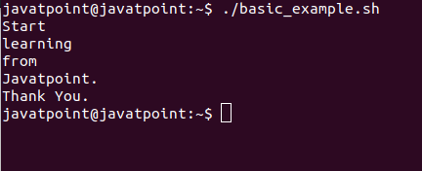

Slide 28
#!/bin/bash
#This is the basic example to print a series of numbers from 1 to 10.
for num in {1..10}
do
echo $num
done
echo "Series of numbers from 1 to 10."

Slide 29
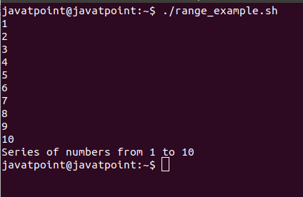

Slide 30
#!/bin/bash
#For Loop to Read a Range with Increment
for num in {1..10..1}
do
echo $num
done

Slide 31
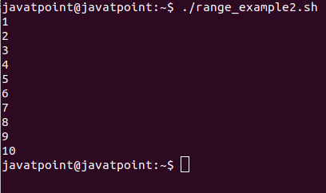

Slide 32
For Decreament
#!/bin/bash
#For Loop to Read a Range with Decrement
for num in {10..0..1}
do
echo $num
done

Slide 33
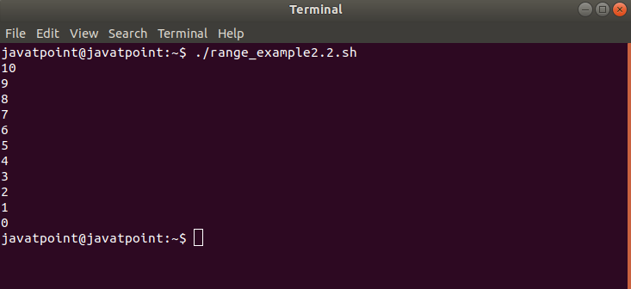

Slide 34
For Loop to Read Three-expression
Three expression syntax is the most common syntax of 'for loop'. The first expression refers to the process of initialization, the second expression refers to the termination, and the third expression refers to the increment or decrement.
Check out the example below to print 1 to 10 numbers using three expressions with for loop:
Bash Script
#!/bin/bash
#For Loop to Read Three-expression
for ((i=1; i<=10; i++))
do
echo "$i"
done

Slide 35
#!/bin/bash
#Table of 2
for table in {2..100..2}
do
echo $table
if [ $table == 20 ]; then
break
fi
done

Slide 36
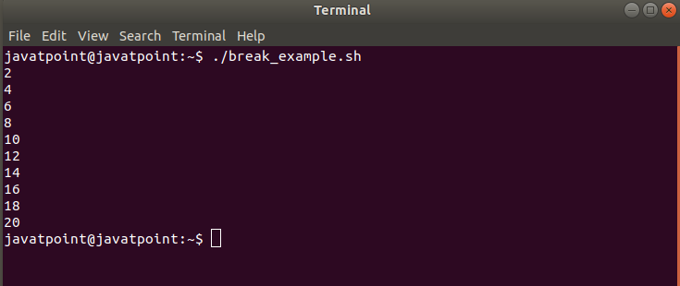

Slide 37
#!/bin/bash
#Numbers from 1 to 20, ignoring from 6 to 15
using continue statement"
for ((i=1; i<=20; i++));
do
if [[ $i -gt 5 && $i -lt 16 ]];
then
continue
fi
echo $i
done

Slide 38
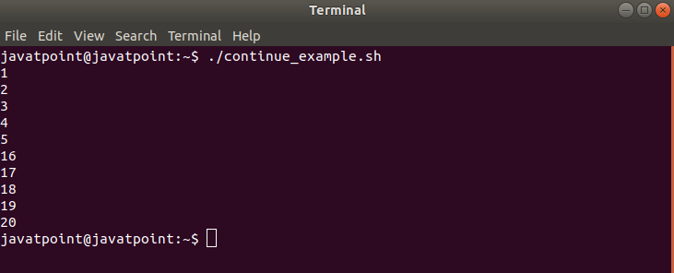

Slide 39
Syntax of Bash While Loop
Bash while loop has the following format:
while [ expression ];
do
commands;
multiple commands;
done

Slide 40
If there are multiple conditions to include in the expression, then the syntax of the while loop will be as follows:
while [ expressions ];
do
commands;
multiple commands;
done
The while loop one-liner syntax can be defined as:
while [ condition ]; do commands; done
while control-command; do Commands; done

Slide 41
#!/bin/bash
#Script to get specified numbers
read -p "Enter starting number: " snum
read -p "Enter ending number: " enum
while [[ $snum -le $enum ]];
do
echo $snum
((snum++))
done
echo "This is the sequence that you wanted."

Slide 42
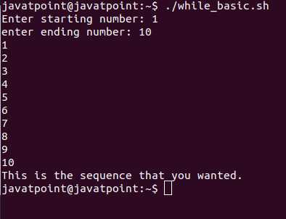

Slide 43
While Loop with C-Style
We can also write while loop in bash script as similar as a while loop in C programming language.
#!/bin/bash
#While loop example in C style
i=1
while((i <= 10))
do
echo $i
let i++
done

Slide 44
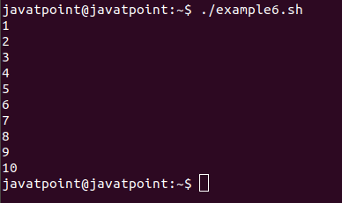

Slide 45
The syntax of until loop looks almost similar to the syntax of bash while loop. But there is a big difference in the functionalities of both. The syntax of bash until loop can be defined as:
until [ expression ];
do
command1
command2
. . .
. . . .
commandN
done

Slide 46
Until Loop with Single Condition
In this example, the until loop contains a single condition in expression. It is the basic example of until loop which will print series of numbers from 1 to 10:
Example
#!/bin/bash
#Bash Until Loop example with a single condition
i=1
until [ $i -gt 10 ]
do
echo $i
((i++))
done

Slide 47
